Slide 1



Slide 2
INPUT DEVICES ARE PROVIDING DATA TO COMPUTER. THE MOST USED ARE:
Keyboard
Mouse
Microphone
Scanner
Webcam
Bar code reader
Optic pen
Joystick
Touch screen monitor
Following

Slide 3

DEVICES THAT ARE USED THE COMPUTER TO SHOW RESULTS. THE MOST USED ARE:
Screen or monitor
Printer
Speakers
Headphones
Plotters
Fax
Back

Slide 4
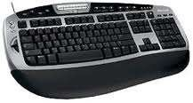
Keyboard
Is used to

Slide 5
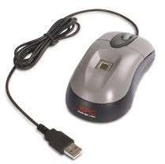
Mouse
Is used to

Slide 6
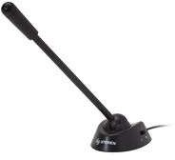
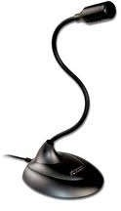
Microphone
Is used to

Slide 7
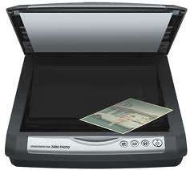
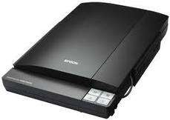
Scanner
Is used to

Slide 8
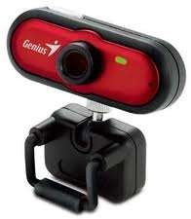
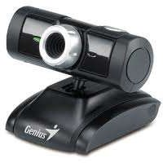
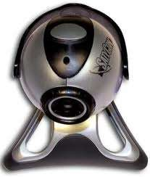
Webcam
Is used to

Slide 9
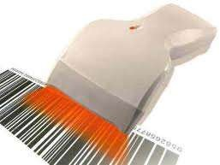
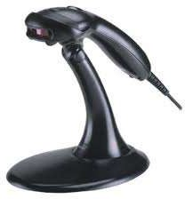
Bar Code Reader
Is used to

Slide 10
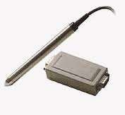
Optic Pen
Is used to

Slide 11
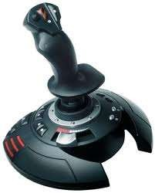
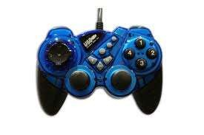
Joystick
Is used to

Slide 12
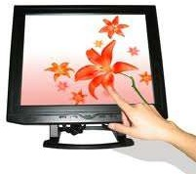
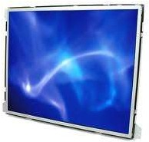
Touch Screen Monitor
Is used to

Slide 13
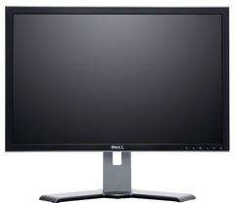
Screen or Monitor
Is used to

Slide 14
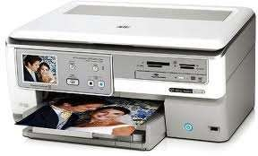
Printer
Is used to

Slide 15
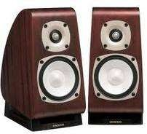
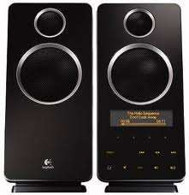
Speakers
Is used to

Slide 16
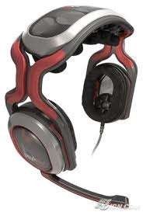
Headphones
Is used to

Slide 17
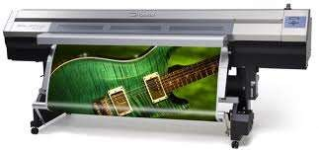
Plotters
Is used to

Slide 18
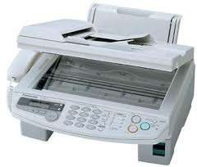
FAX
Is used to

